Slide 1

Coffee Shop Data Analysis
Created by Sumit Jha
Date: 13/09/2024

Slide 2
Objective:
The objective of this analysis is to uncover actionable insights and provide recommendations from the "Coffee Shop Data" datasets to support data-driven decisions and enhance business operations.
Throughout the analysis, seven different tables were used: Orders, Items, Recipes, Ingredients, Inventory, Staff, Shifts, and Rota.

Slide 3
Sections of the Analysis:
1: Sales Analysis
2: Recipe and Ingredient Usage Analysis
3: Ingredient Cost Analysis
4: Inventory and Ingredient Stock Analysis
5: Staff Scheduling Analysis
6: Item Profitability Analysis

Slide 4
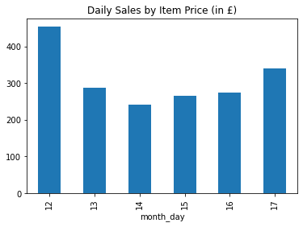
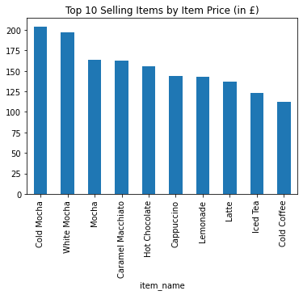
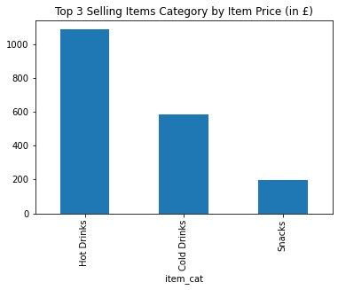
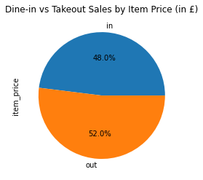
1: Sales Analysis
Key Insights:
1. Total sales over the period were £1,863. Sales were highest on day 12 (£454), then decreased until day 16, and increased again on day 17 (£339). Average daily sales were about £310.
2. Customers have spent more on Takeaway than on Dine-In, indicating a higher demand for Takeaway orders.
3. Cold Mocha (13.6%) and White Mocha (13.2%) are the top-selling items, indicating they are the most popular beverages among customers. Cold Coffee is the least popular, generating the lowest sales.
4. In terms of item categories, Hot Drinks (58%) are the top sellers, followed by Cold Drinks (31%). Snacks are less popular (11%).
Notes:
Out of the 521 order records in the orders table, 430 are unique, while 91 are duplicate orders, as some customers placed multiple items.
Two additional charts could be added such as top 5 Items by dine-In vs takeaway and top 5 items by item category to provide more granular level analysis.

Slide 5
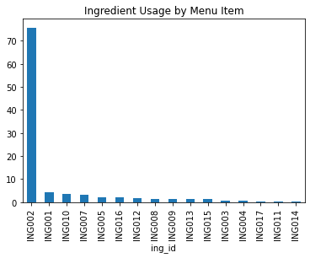
2: Recipe and Ingredient Usage Analysis
Key Insights:
1. Ingredient usage is heavily skewed, with one ingredient (ING002- Whole Milk) dominating the total. Most other ingredients are used in relatively small amounts.
2. The extremely high usage of ING002 (76%) suggests it is essential to many recipes, making it a core ingredient.
3. ING011 and ING014 are rarely used, showing they are not needed in many recipes.
4. Most ingredients are used in small quantities, indicating a wide variety of recipes.
Notes:
There are a total of 14 unique SKUs or recipes, out of which 10 have multiple item sizes, such as medium and large. There are a total of 18 ingredients used in different recipes.
ING002 is used in 9 out of 14 distinct recipes, whereas ING011 and ING012 are used in 1 and 2 recipes, respectively.

Slide 6

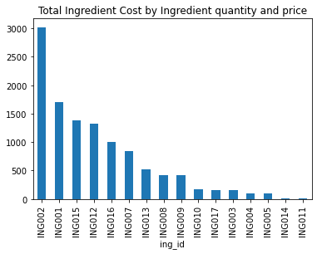
3: Ingredient Cost Analysis
Key Insights:
1. ING002 is the major cost driver, representing the largest expense among ingredients.
2. ING001 and ING015 also incur significant costs, showing their importance in recipes.
3. Most other ingredients have lower costs, with ING014 and ING011 being the least expensive.
Notes:
ING001 – Whole Milk (27%), ING001 – Espresso Beans (15%), and ING015 – Ham (12%) together make up 54% of the total expenses for all ingredients.

Slide 7
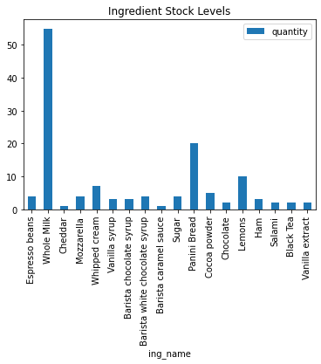
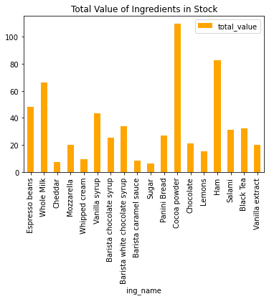
4: Inventory and Ingredient Stock Analysis
Key Insights:
1. Cocoa Powder (£110) and Ham (£82.50) have the highest total values, indicating they are both expensive and used in significant quantities.
2. Whole Milk is important because of its high stock level, showing it’s a key ingredient with a large inventory.
3. Many ingredients have lower total values, indicating they are less costly or used less frequently.

Slide 8

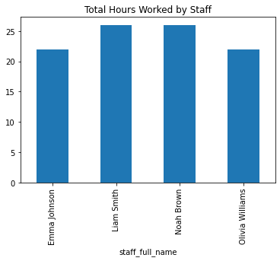
5: Staff Scheduling Analysis
Key Insights:
1. Staff hours are relatively evenly distributed, with two staff members working 22 hours and two working 26 hours.
2. The coffee shop might need to review and adjust the schedule to ensure that work hours are fairly distributed among all staff.
Number of shifts between staff members
Staff Name | Emma Johnson | Liam Smith | Noah Brown | Olivia Williams
Day of Week
Friday | 1 | 2 | NaN | NaN
Monday | 2 | NaN | NaN | 1
Saturday | NaN | NaN | 2 | 1
Thursday | NaN | 1 | 2 | NaN
Tuesday | NaN | 2 | 1 | NaN
Wednesday | 1 | NaN | NaN | 2

Slide 9

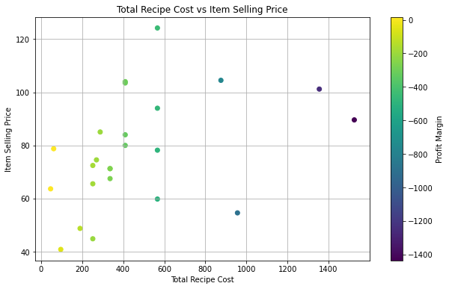
6: Item Profitability Analysis
Key Insights:
1. Most recipes have negative profit margins, where production costs exceed selling prices. For example, the SNK-SHC recipe shows the largest loss at -£1435.75 overall.
2. Only a few recipes, like CDR-LMN-LG and CDR-LMN-MD, are profitable and help boost overall revenue.
3. Top Performers: Recipes with positive profit margins include:
CDR-LMN-LG: Profit margin of £17.25
CDR-LMN-MD: Profit margin of £17.15
4. Bottom Performers: Recipes with the largest losses include:
SNK-SHC: Profit margin of -£1435.75
HDR-HCH-LG: Profit margin of -£1253.80

Slide 10
Recommendations
Increase inventory and marketing efforts for Takeaway orders and Hot Drinks.
Review the heavy use of ING002 (Whole Milk) and consider either using it more efficiently or finding alternative sources to reduce costs.
Re-evaluate and balance staff work hours to ensure fair distribution and improve overall efficiency.
Focus on managing stock levels for high-value ingredients like Cocoa Powder and Ham, and review cost control for major items like ING002 (Whole Milk).
Analyse and adjust recipes with negative profit margins and focus on improving the profitability of low-performing items.
Promote top-selling items like Cold Mocha and White Mocha to increase overall sales.

Slide 11

Thank You!

